Slide 1
Lecture #13 :
Inheritance – Extending classes
COMP 116: Object Oriented Programming
Presented by:
Roshan Manjushree Adhikari
Kathmandu University
20th June, 2018

Slide 2
What is Inheritance ???
Reusability is an important feature of OOP.
Lets the programmer reuse something that already exists rather than trying to create things from scratch.
Inheritance lets us reuse existing classes.
Inheritance means simply deriving new classes from an old one.
Old class is called base class and new one is called derived class or subclass.
“IS-A” relationship.

Slide 3

Chair wars
There will be shapes on a GUI, a square, a circle and a triangle. When the user clicks ona shape, the shape wil rotate clockwise 360⁰ and play a sound specific to that shape.

Slide 5
How will you design this program ?
Square
Circle
Triangle
rotate()
playSound()
rotate()
playSound()
rotate()
playSound()

Slide 6
When you have duplicate code in similar classes, it is a good sign that you should use inheritance.

Slide 7
Adding Inheritance to Chair Wars
Square
Circle
Triangle
rotate()
playSound()
rotate()
playSound()
rotate()
playSound()
Look at what all four classes have in common

Slide 8
They’re shapes, and they all rotate and playSound. So abstract out the common features and put them into a new classs called Shape.
Shape
rotate()
playSound()

Slide 9
Then link four shape classes to a new Shape class, in a relationship called Inheritance.
Shape
rotate()
playSound()
Square
Circle
Triangle

Slide 10
Shape
base class
(more abstract)
rotate()
playSound()
Square
Circle
Triangle
Derived class
(more specific)

Slide 11

But wait !! There’s been a change
There will be amoeba shape on the screen, with the others. When the user clicks on amoeba, it will rotate like others, and play a sound file.
Note : Point of rotation of amoeba is different from other shape.
point of rotation

Slide 12

Shape
rotate()
playSound()
Overriding methods
Square
Circle
Triangle
Amoeba
rotate() {
//amoeba-specific //rotate code }
playSound() {
//amoeba-specific //sound code }

Slide 13
What’s the problem with the approach with four different unrelated classes without inheritance ?
Repeated code
Not adaptive to a change
Difficult to maintain a large code
..... and so on.....

Slide 14
Animal simulation program
using Inheritance

Slide 15




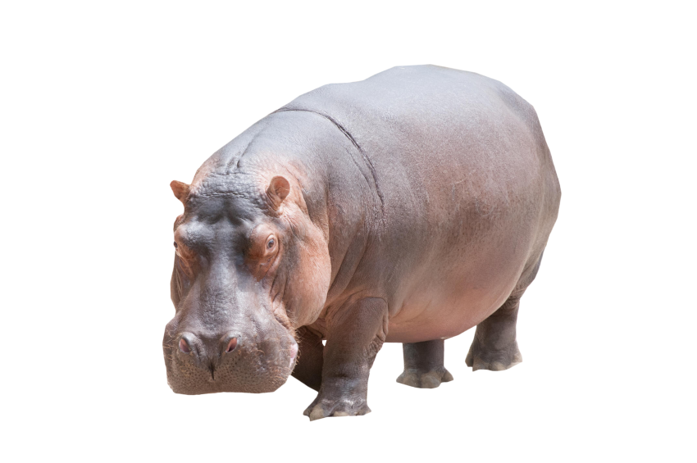
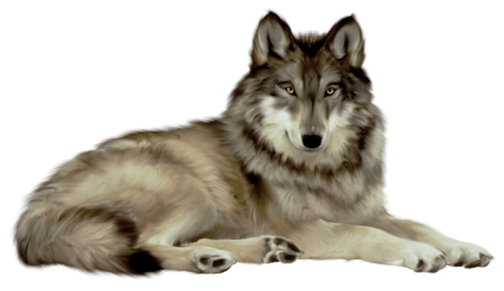

Slide 16
Look for objects that have common attributes and behaviours
1
What do these six types have in common? This helps you to abstract out behaviours.

Slide 17
2
Design a class that represents the common state and behavior.
These objects are all animals, so we’ll make a common base class called Animal.
We’ll put in methods and instance variables that all animals might need.

Slide 18
Wolf
Animal
picture
food
hunger
boundaries
location
Tiger
Lion
makeNoise()
eat()
sleep()
roam()
Hippo
Dog
Cat

Slide 19
Decide if a derived class needs behaviours that are specific to that particular derived type.
3
Looking at the Animal class,
we decide that eat() and makeNoise() should be overridden by the individual deried classes.

Slide 20
Doctor
one method in base class
Overrides the inherited treatPatient() method
Adds one
new method
treatPatient()
Adds one new method
Surgeon
FamilyDoctor
treatPatient()
makeIncision()
giveAdvice()

Slide 21
Does this makes sense ?
Oven is derived from Kitchen.
Guitar is derived from Instrument.
Person is derived from Employee.
Ferrari is derived from Engine.
FriendEgg is derived from Engine.
Metal is derived from Titanium.
Tea is derived from beverage.
Hint : apply the IS-A Test

Slide 22
A
A
B
B
Single inheritance
A
B
C
Multilevel inheritance
C
Multiple inheritance

Slide 23
A
Hybrid
inheritance
A
B
C
D
Hierarchaical
inheritance
B
C
D

Slide 24
Defining derived classes
class derived-class-name : visibility-mode base-class-name
{
......
...... //members of derived class
......
};

Slide 25
Say this as:
derived-class is derived from base-class-name
Visibility mode is optional (private or public)
Default visibility mode is private.
Private inheritance:
public of base become private of derived
Inaccessibke to objects of derived class
No member of base class is accessible to the objects of the derived class

Slide 26
Publicly inherited
public of base class becomes public of derived class
In both cases, private members are not inherited and so, private members of a base class will never become the members of its derived class.

Slide 27
Single Inheritance

